Slide 1
Lecture 4
Divide and Conquer

Slide 2
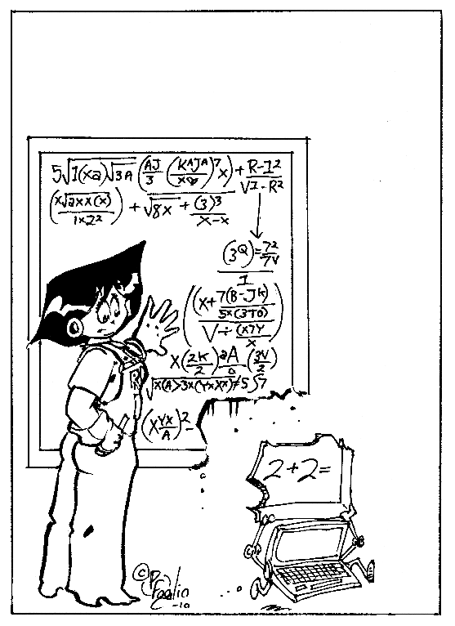
Divide and Conquer
Breaking large problems into smaller sub-problems

Slide 3

Dictionary
Suppose you want to find “janissary” in a dictionary.
What do you do?
Open the book near the middle
The heading on the top left page is “kiwi”, so move back a small number of pages.
Here you find “hypotenuse”, so move forward.
Find “ichthyology”, move forward again
The number of pages you move gets smaller (or at least adjusts in response to the words you find)

Slide 4
Reduction in Search space
Group of pages
Single page
Group of words

Slide 5
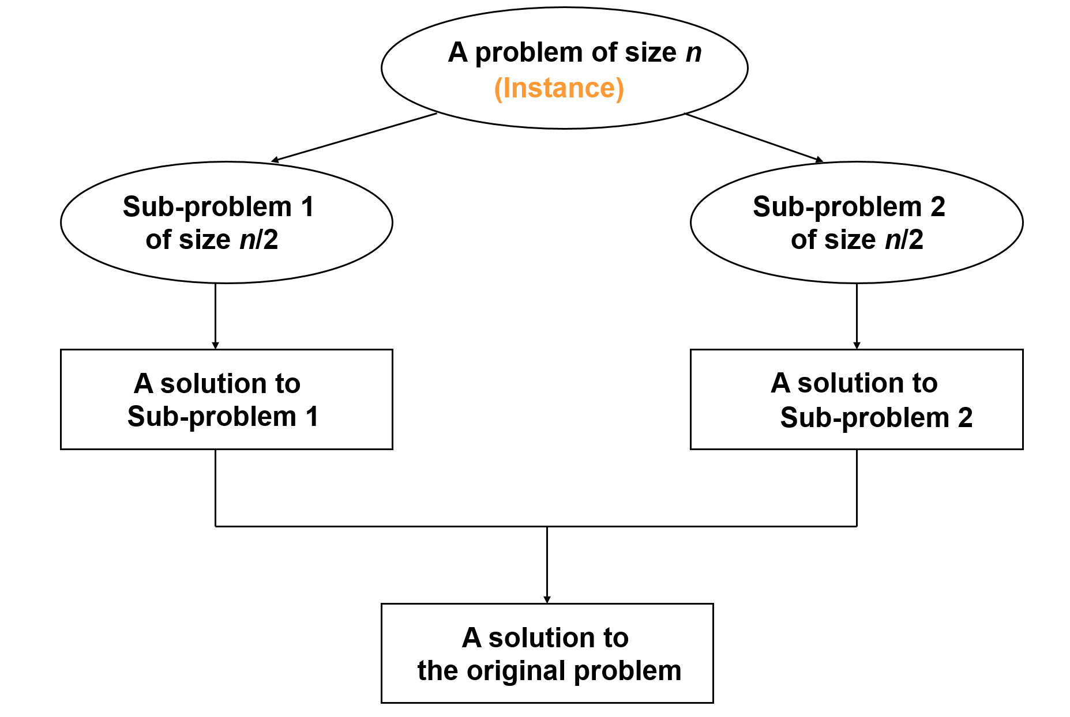
The Methodology
It general leads to a recursive algorithm!

Slide 6
The Divide and Conquer Technique
If the input size is too large to deal with in a straightforward manner, divide the data into two or more disjoint subsets.
“Merge” these solutions into a solution for the original problem.
Take the solutions to the sub-problems by solving them recursively
DIVIDE
CONQUER
COMBINE

Slide 7
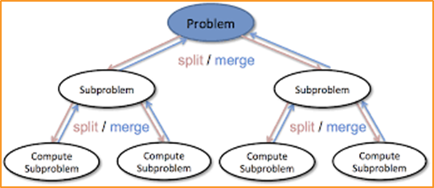
Applications
The divide and conquer strategy used to make a more efficient search algorithm can also be applied to sorting.
Two well-known sorting algorithms:
Quick Sort
divide a list into big values and small values, then sort each part
Merge Sort
sort subgroups of size 2, merge them into sorted groups of size 4, merge those into sorted groups of size 8, ...

Slide 8
An Example: Merge Sort
Problem: Sort a sequence of n elements into non-decreasing order.
Divide: Divide the n-element sequence to be sorted into two subsequences of n/2 elements each.
Conquer: Sort the two subsequences recursively using merge sort.
Combine: Merge the two sorted subsequences to produce the sorted answer.

Slide 9
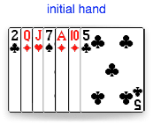
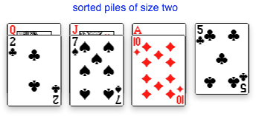
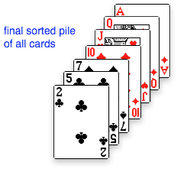
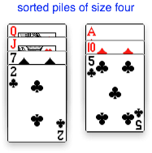
How merge sort works?

Slide 10
Merge Sort – Example
18
26
32
6
43
15
9
1
18
26
32
6
43
15
9
1
1
6
9
15
18
26
32
43
18
26
32
6
43
15
9
1
18
26
32
6
43
15
9
1
6
26
32
6
18
26
32
18
1
9
15
43
1
9
15
43
18
26
43
15
9
1
18
26
32
6
43
15
9
1
32
6
18
26
6
32
15
43
18
26
6
32
15
43
1
9
1
9
18
26
32
15
1
15
18
26
32
6
43
15
9
1
26
32
9
6
43
9
18
26
6
43
15
9
1
18
32
6
43
1
18
26
32
6
43
15
9
1
18
26
32
6
43
15
9
1

Slide 11
Merge sort Algorithm
void merge_sort (int A[ ] , int start , int end )
{
if( start < end ) {
int mid = (start + end ) / 2 ; // defines the current array in 2 parts .
merge_sort (A, start , mid ) ; // sort the 1st part of array .
merge_sort (A,mid+1 , end ) ; // sort the 2nd part of array.
// merge the both parts by comparing elements of both the parts.
merge(A,start , mid , end );
}
}

Slide 12
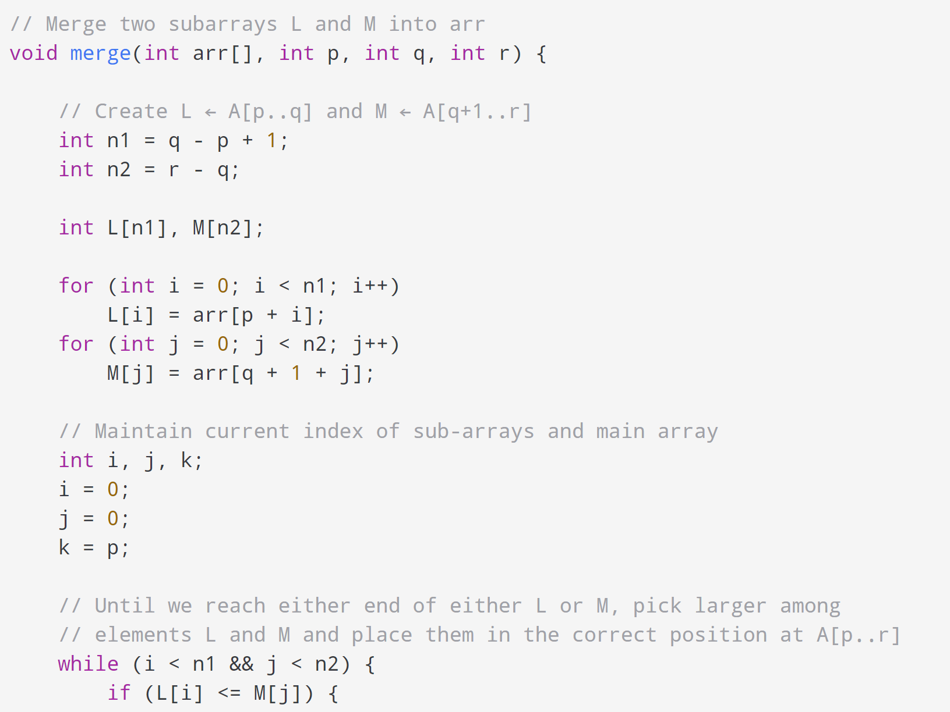
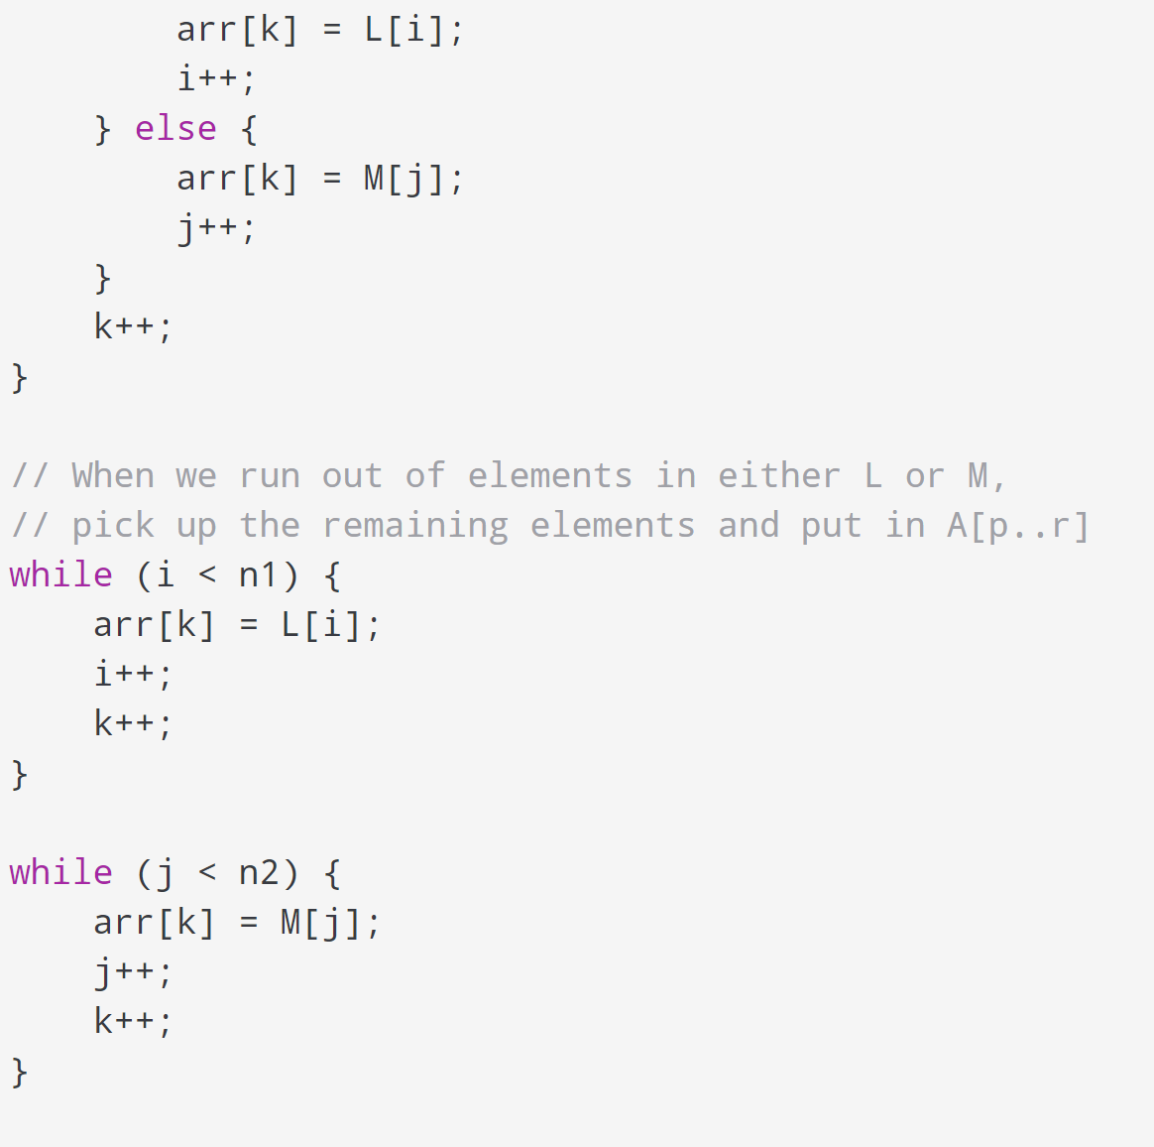
Merge algorithm

Slide 13

Analysis of Merge sort
Recurrence Relation:
T(n) = 2T(n/2) + Θ(n), T(1) = 0
All cases have same efficiency: Θ(n log n)

Slide 14
Quicksort
The main idea is to partition the array into two regions:
small items are moved to the left side of the array
large items are moved to the right side
After partitioning, repeat the sort on the left and right sides
Use the first item in the region as a pivot
Exchange the pivot with the last element in the first subarray — the pivot is now in its final position
Sort the two sub-arrays recursively
p
A[i]≤p
A[i]≥p

Slide 15






Example: Quicksort
The partitioning algorithm works from both ends
When it finds a large item on the left and a small item on the right it swaps them
When there are no more exchanges to make the two regions are complete
Numbers below 79
Numbers 79 and above

Slide 16
Quick sort algorithm
void quick_sort ( int A[ ] ,int start , int end ) {
if( start < end ) {
//stores the position of pivot element
int piv_pos = partition (A, start , end ) ;
quick_sort (A,start , piv_pos -1); //sorts the left side of pivot.
quick_sort ( A,piv_pos +1 , end) ; //sorts the right side of pivot.
}
}
Base case: empty region
The call to partition returns the location of the boundary between sub-regions
Recursive calls to sort each sub-region

Slide 17
Partition algorithm
int partition ( int A[],int start ,int end) {
int i = start + 1;
int piv = A[start] ; //make the first element as pivot element.
for(int j =start + 1; j <= end ; j++ ) { /*rearrange the array by putting elements which are less
if ( A[ j ] < piv) { pivot on one side and which are greater that on other. */
swap (A[ i ],A [ j ]);
i += 1;
}
}
swap ( A[ start ] ,A[ i-1 ] ) ; //put the pivot element in its proper place.
return i-1; //return the position of the pivot
}

Slide 18
Analysis of Quicksort
Recurrence Relation: T(n) = T(n-1) + Θ(n)
Worst case
Already sorted array
Θ(n²)
Best case
Split in the middle
Average case
Random arrays
Θ(n log n)
Θ(n log n)

